Slide 1
Objectives
In this session, you will learn to:
  Describe the concept of a master page
  Describe the concept of a content page
  Describe nested master pages
  Design master pages
  Configure content pages
  Design nested master pages

Slide 2
What Are Master Pages?
Master pages:
  Are ASP.NET files similar to ASP.NET Web Forms.
  Define consistent, reusable layouts, code, and content that is typically used by more than one Web page in a Web application.
  Have a file extension of .master.
  Contain the @Master directive.
  Do not represent complete Web pages. The content and functionality is incorporated with other Web pages on the same Web site at run time.
Notes:
Provide the example code of @Master directive, Explain how layout, code and content can be reused. Also tell the alternate activity used for the same purpose

Slide 3
What Are Master Pages? (Contd.)
Advantages of using master pages:
  Allow centralization of the common functionality of Web pages.
  Make it easy to create one set of controls and code and apply the results to a set of pages.
  Provide fine-grained control over the layout of Web pages.
  Allow customization of master page from the individual content pages.
Notes:
Discuss the advantages with examale

Slide 4
What Are Master Pages? (Contd.)
ASP.NET includes a handler that prevents master pages from being served directly to a browser.
When a Web page references a master page, ASP.NET:
  Fetches the requested Web page.
  Fetches the master page referenced by the requested Web page.
  Merges the content from the master page with that of the requested Web page.
  Sends the merged results to the browser.
Notes:
Explain the sequence, Define the role of ContentPlaceHoder with an example

Slide 5
What Are Master Pages? (Contd.)
Designing a Master Page:
  Master page typically includes one or more ContentPlaceHolder controls identified by their ID attributes.
  ContentPlaceholder control provides a location where content from referencing pages will be merged at run time.
  HTML markup, HTML controls, and Web server controls (outside the ContentPlaceHolder control) can also be added to the page.
  Any server-side code can also be added to the master page.
Notes:
Explain @page directive with example, explain the relationship between Content control and ContentPlaceholder Control

Slide 6
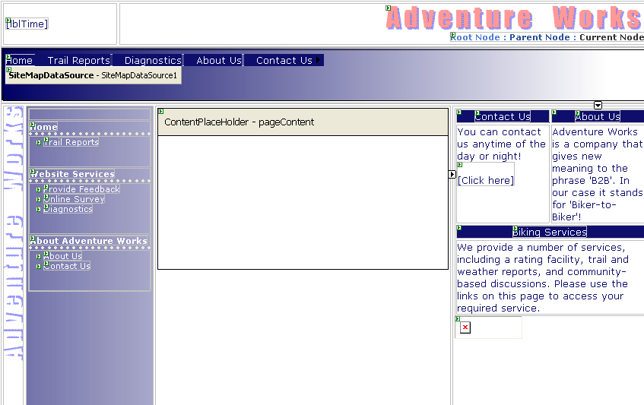
What Are Master Pages? (Contd.)
Content Place Holder
Control
Notes:
Explain @page directive with example, explain the relationship between Content control and ContentPlaceholder Control

Slide 7
What Are Content Pages?
Content Pages:
  Reference a master page for consistent layout, reusable code, reusable content, and controls.
  Enable you to create specific content that is included at run time with the generic content from a master page.
  Reference a master page by including a MasterPageFile attribute in the @Page directive.
  Contain page-specific content in Content controls. These Content controls are merged at run time with corresponding ContentPlaceholder controls on the referenced master page.
Notes:
Explain @page directive with example, explain the relationship between Content control and ContentPlaceholder Control

Slide 8
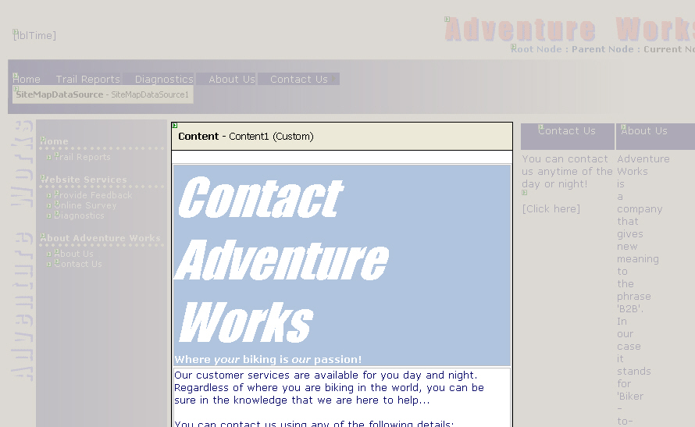
What Are Content Pages? (Contd.)
Page-Specific Content
Notes:
Explain @page directive with example, explain the relationship between Content control and ContentPlaceholder Control

Slide 9
Nested Master Pages
When a master page references another master page, the referencing page is known as a child master, and the referenced page is called the parent master.
A child master page references a parent master page by including the MasterPageFile attribute in the @Master directive.
A nested master page can include additional content within its Content controls.
These Content controls correspond to ContentPlaceHolder controls on the parent master.
Child master pages typically contain their own ContentPlaceHolder controls that will be used by content pages.
Notes:
Explain with the example given in CG

Slide 10
How to Create Nested Master Pages
To create a nested master page, the following three files may be created:
  Parent.master: Acts as a parent master file.
  Child.master: Acts as a child master file that references the Parent.master page.
  Child.aspx: Acts as a child file that references the Child.master page .

Slide 11
How to Create Nested Master Pages (Contd.)
Parent.master file:
  <%@ Master Language="C#" %>
  <HTML>
  <BODY>
  ----------Some Tags---------
  <asp:ContentPlaceHolder ID="MainContent"
  runat="server“ />
  ----------Some Tags---------
  </BODY>
  </HTML>

Slide 12
How to Create Nested Master Pages (Contd.)
Child.master file:
<%@ Master Language="C#“ MasterPageFile="Parent.master"%>
  <asp:Content id="Content1“ ContentPlaceholderID="MainContent" runat="server">
--------------Some Tags--------
    <asp:ContentPlaceHolder ID= "ChildContent" runat="server" />
--------------Some Tags----------
  <asp:ContentPlaceHolder ID="ChildFooter“ runat="server" />
-----------Some Tags------------
  </asp:Content>

Slide 13
How to Create Nested Master Pages (Contd.)
Child.aspx file:
  <%@ Page Language="C#“ MasterPageFile="Child.Master"%>
    <asp:Content id="pageContent" ContentPlaceholderID="ChildContent" runat="server">
  ----------Some Tags---------
    </asp:Content>
    <asp:Content id="footerContent" ContentPlaceholderID="ChildFooter" runat=server>
  ----------Some Tags---------
    </asp:Content>

Slide 14
Demo: Creating a Common Layout by Using Master Pages
Problem Statement:
  You are a developer in the Adventure Works organization, a fictitious bicycle manufacturer. You have been asked to assist in the development of the Business-to-Consumer (B2C) Web application and a related Business-to-Employee (B2E) extranet portal.
  Decisions on the design of the application have already been made. You have been asked to carry out a number of specific tasks in order to implement various elements of this design. As part of the first phase of the B2C development, you have been asked to implement a hierarchy of master pages that enable commonly used user interface elements to be defined in one place and then reused in many Web pages throughout the site.

Slide 15
Demo: Creating a Common Layout by Using Master Pages (Contd.)
Solution:
  You need to perform following tasks:
    Design a Master Page
      Open the Adventure Works Web site.
      Create the TopLevel.master page.
      Define the layout of the TopLevel.master page.
      Write code for the TopLevel.master page.

Slide 16
Demo: Creating a Common Layout by Using Master Pages (Contd.)
    Add and Configure Content Pages
      Add a new Contact.aspx Web page.
      Define the layout of the new Contact.aspx Web page.
      Add code to the Contact.aspx page.
      Specify the master page for the existing Default.aspx Web page.
      Programmatically access controls on the master page from the Default.aspx content page.
      Add preconfigured content Web pages to the Adventure Works Web site.

Slide 17
Demo: Creating a Common Layout by Using Master Pages (Contd.)
    Design Nested Master Pages
      Add a nested master page.
      Design the nested master page.
      Add content pages for the nested master page.
      Test the Adventure Works Web site.
      Modify the TopLevel.master page.

Slide 18
Summary
In this session, you learned that:
  Master pages are ASP.NET files with the .master extension.
  Master pages define consistent, reusable layouts, code and content for multiple Web pages.
  Master pages are not sent to the browser directly.
  Master page elements are merged with referencing Web pages at run time.
  Merged content is sent to the browser.
  Content pages are Web pages that reference a master page.
  Content pages include their own page-specific content that is merged with the master page at run time.
  A master page can reference another master page.

